Slide 1
Coffeehouse Franchise Analysis
Francisco Aceves
Apache Hive Project1

Slide 2





Technology Stack
Apache Hive 2.3.8
HDFS
YARN
DBeaver
Ubuntu

Slide 3
Dataset Overview
Branches
Counts
Column Name | Data Type
Beverage | String
Branch | String
Column Name | Data Type
Beverage | String
Counts | String

Slide 4
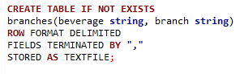
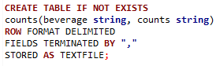
Create Tables
Branches
Counts

Slide 5
Load Tables
Branches
Counts

Slide 6
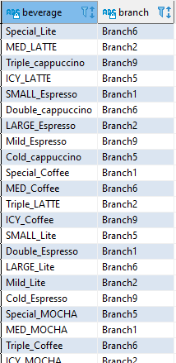
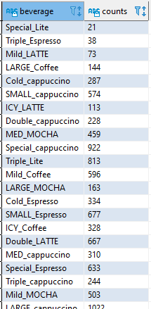
Populated Tables
Branches
Counts

Slide 7
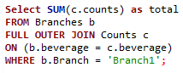
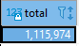
Scenario 1
Problem 1: What is the total number of consumers for Branch1?
Hive Query:
Output:

Slide 8
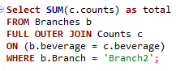
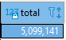
Scenario 1
Problem 2: What is the total number of consumers for Branch2?
Hive Query:
Output:

Slide 9
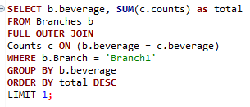
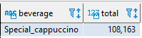
Scenario 2
Problem 1: What is the most consumed beverage on Branch1?
Hive Query:
Output:

Slide 10
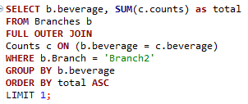
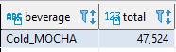
Scenario 2
Problem 2: What is the least consumed beverage on Branch2?
Hive Query:
Output:

Slide 11
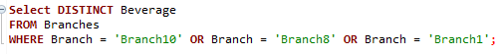
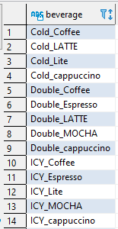
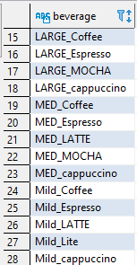
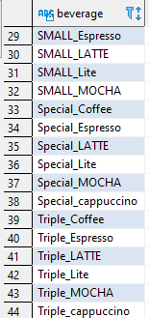
Scenario 3
Problem 1: What are the beverages available on Branch10, Branch8, and Branch1?
Hive Query:
Output:

Slide 12
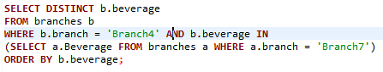
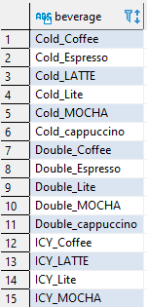
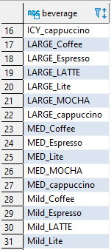
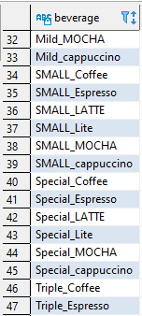
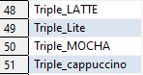
Scenario 3
Problem 2: What are the common beverages available in Branch4, Branch7?
Hive Query:
Output:

Slide 13
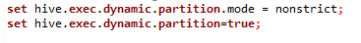
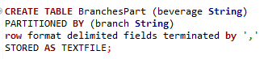
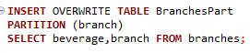
Scenario 4
Create a partition, index, view for Scenario3.
Problem 1: What are the beverages available on Branch10, Branch8, and Branch1?
Partition
Hive Query:

Slide 14
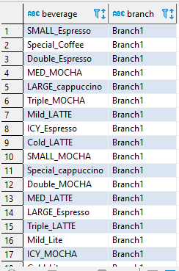
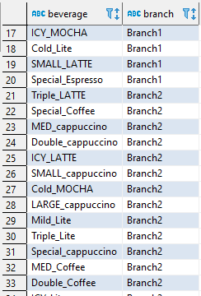
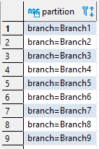
Scenario 4
Create a partition, index, view for Scenario3.
Problem 1: What are the beverages available on Branch10, Branch8, and Branch1?
Partition
Output:

Slide 15
Scenario 4
Create a partition, index, view for Scenario3.
Problem 1: What are the beverages available on Branch10, Branch8, and Branch1?
Index
Hive Query:

Slide 16
Scenario 4
Create a partition, index, view for Scenario3.
Problem 1: What are the beverages available on Branch10, Branch8, and Branch1?
Index
Output:

Slide 17
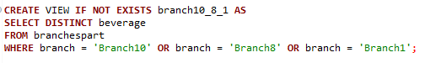
Scenario 4
Create a partition, index, view for Scenario3.
Problem 1: What are the beverages available on Branch10, Branch8, and Branch1?
View
Hive Query:

Slide 18
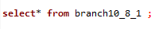
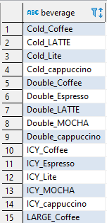
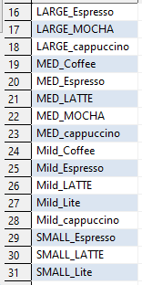
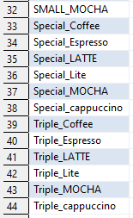
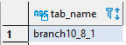
Scenario 4
Create a partition, index, view for Scenario3.
Problem 1: What are the beverages available on Branch10, Branch8, and Branch1?
View
Output:

Slide 19
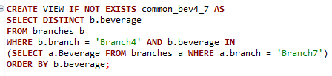
Scenario 4
Create a partition, index, view for Scenario3.
Problem 2: What are the common beverages available in Branch4, Branch7?
View
Hive Query:

Slide 20
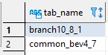
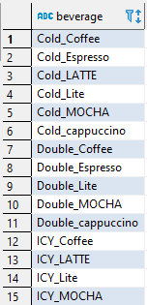
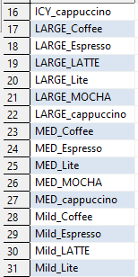
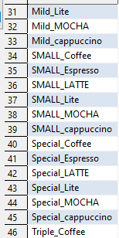
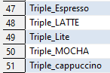
Scenario 4
Create a partition, index, view for Scenario3.
Problem 2: What are the common beverages available in Branch4, Branch7?
View
Output:

Slide 21
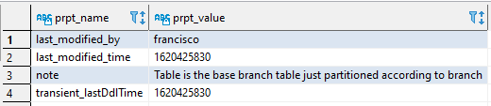
Scenario 5
Alter the table properties to add "note", "comment".
Hive Query:
Output:

Slide 22
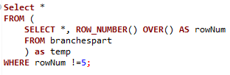
Scenario 6
Remove the row 5 from the one of the tables of Scenario 3
Hive Query:

Slide 23
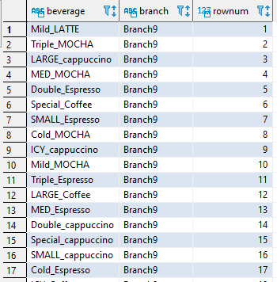
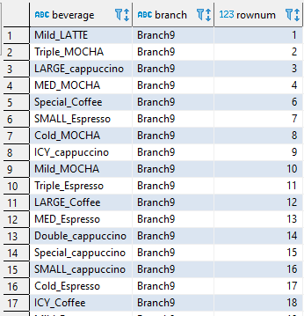
Scenario 6
Remove the row 5 from the one of the tables of Scenario 3
Output:
Before
After

Slide 24

Thank you!
Any questions?
Francisco.Aceves@revature.net

